Slide 1

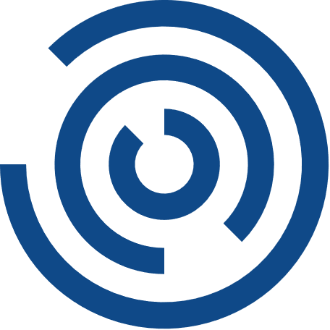




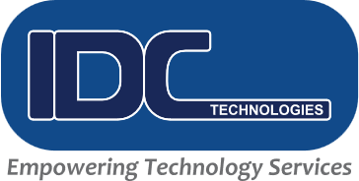


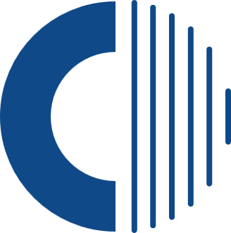
Application Development & Modernization
Notes:
Generated by Copilot There's not enough content in this slide for me to generate speaker notes ______

Slide 2
Company Highlights
Global Presence
Industry Certified
Industry Leadership
North America, Europe, Australia, Singapore, Malaysia, UAE, & India
NMSDC Certified MBE, BBB Certified Business, E-Verify Certified, ISO 9001:2015, ISO 27001:2013, ISO 20000-1:2011 Certified. Also, CMMI Level 3 Certified.
Seasoned experts & leaders trailblazing digital solutions for all sectors
Founded
Headquarter
No. of Years
Served
Guiding Innovation with Growth & Proven Expertise
IDC Technologies was Founded in 2003
Headquartered in Milpitas, CA
21 Years
5500+ Employees Globally
Notes:
Generated by Copilot IDC Technologies was founded in 2003 and is headquartered in Milpitas, California. With over 21 years of experience, the company has grown to employ more than 5,500 professionals worldwide. IDC is recognized for its leadership in digital solutions across various industries, backed by multiple certifications including NMSDC MBE, BBB, E-Verify, ISO standards, and CMMI Level 3. Their global presence spans North America, Europe, Australia, Singapore, Malaysia, UAE, and India, reflecting a strong international footprint and commitment to innovation and growth. ______

Slide 3

IDC Technologies
Netherlands
We co-create your Digital Future
London
Canada
Poland
Boston
Germany
Staffing, Digital and Application services being delivered seamlessly with global workforce of 5500+ professionals
Denver
San Francisco
New York
Noida
Austin
Gurugram
Mexico
Bengaluru
Malaysia
Costa Rica
Dubai
Washington
Abu Dhabi
Singapore
Agile Transformation
Pune
DevOps/SRE
Chennai
Software Engineering
Application Development
Big Data, AI, ML, RPA
Sydney
Cloud Architecture
Wellington
Automation/ AIOps
Infrastructure Services
Our Global Footprint
Application Maintenance
Cyber Security
21 Years Successive Growth
Notes:
Generated by Copilot IDC Technologies has experienced 21 years of continuous growth, delivering staffing, digital, and application services through a global workforce of over 5,500 professionals. Their expertise spans application development and maintenance, big data, AI, machine learning, robotic process automation, cloud architecture, DevOps, software engineering, agile transformation, infrastructure services, automation, AIOps, and cybersecurity. This broad service portfolio enables IDC to co-create digital futures tailored to client needs, ensuring seamless delivery and innovation. ______

Slide 4




Welcome to IDC Digital
Empowering Digital Evolution: As the leading digital and technology division of IDC Technologies, we empower organizations to flourish in the digital era with the latest innovations and solutions.
IDC Digital Services
IDC Manpower Services
IDC TECHNOLOGIES
IDC Digital’s comprehensive suite of end-to-end digital and smart services addresses all traditional and transformational needs. We are a one-stop IT Service Provider for accelerating your business objectives using best-in-class consulting & technology solutions.
© 2025 IDC Technologies. All rights reserved - Confidential
Notes:
Generated by Copilot IDC Digital, the technology division of IDC Technologies, empowers organizations to thrive in the digital era by providing innovative solutions and services. They offer a comprehensive suite of end-to-end digital and smart services that address both traditional IT needs and transformational initiatives. Acting as a one-stop IT service provider, IDC Digital accelerates business objectives through best-in-class consulting and technology solutions, ensuring clients stay competitive and agile in a rapidly evolving market. ______

Slide 5
IDC Digital | Our Offering Stack
IDC Digital
Digital Disruption
Application Modernization
Platform Enablement
Smart Services
Cyber Security
Operations Support
Digital Transformation
Omni Channel Microservices
DevSecOps
Data Platform Transformation
Vulnerability Assessment and Pen Testing
Managed Support
Strategy And Consulting
Cloud First
Site Reliability Engineering
Artificial Intelligence and Machine Learning
Managed Detection and Response
L1/L2 Outsourcing
Enterprise Modernization
Quality Engineering
Observability
Blockchain
IAM and GRC
Operations Management
Multi Speed
Mobile First
Public and Private Cloud Services Automation
Business Process Automation and RPA
Consulting and Advisory
Operations Reliability
Empowered by IDC Staffing Services
IDC Technologies
Notes:
Generated by Copilot This slide outlines IDC Digital's extensive offering stack, covering key areas such as digital disruption, application modernization, smart services, cybersecurity, and operations support. Their capabilities include digital transformation strategy and consulting, enterprise modernization, multi-speed delivery, omni-channel microservices, cloud-first and mobile-first approaches, quality engineering, data platform transformation, AI and machine learning, blockchain, business process automation, vulnerability assessment, managed detection and response, identity and access management, and comprehensive managed support services. This diverse portfolio enables IDC to address complex client needs across the digital landscape. ______

Slide 6

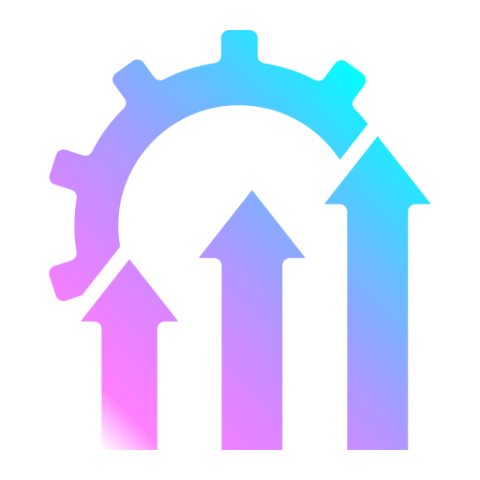

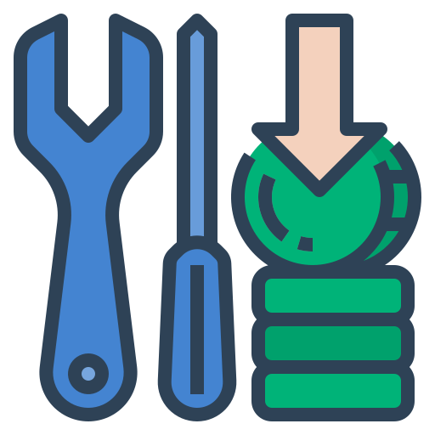
Business Challenges
Technology Advancements
Performance & Scalability
Enhancing Security
Reducing Maintenance Costs
Modernizing the application allows organizations to stay current and competitive in their industry.
Enhance the application which can improve its performance and scalability, allowing it to better meet the needs of users.
Strengthening the security of applications and protecting data sensitivity at multiple layers by using a modern framework.
Cost optimization by offloading infrastructure provisioning and maintenance to cloud provider.
© 2025 IDC Technologies. All rights reserved - Confidential
Notes:
Generated by Copilot Modernizing applications addresses several critical business challenges. Strengthening security at multiple layers protects sensitive data using modern frameworks. Enhancing application performance and scalability ensures better user experience and responsiveness. Staying current with technology trends helps organizations remain competitive. Additionally, modernization reduces maintenance costs by offloading infrastructure provisioning and maintenance to cloud providers, optimizing overall costs while improving operational efficiency. ______

Slide 7
Our Strength
IDC's Global Application Modernization Services allow organizations to capitalize on their existing application investments, maximize IT budgets and minimize the risk of adopting new technologies.
With expertise in DevOps, cloud services, data platforms, and proven modernization strategies, IDC helps organizations achieve their business objectives quickly, lower costs and stay within budget while creating high-quality, innovative digital experiences.
We implement strategies and solutions that keep on-premise infrastructure in sync with cloud platforms. Our comprehensive cloud services include design, proof of concept, and testing to ensure a successful migration to the cloud.
Our Industry Agnostic Offering is:
Certified Cloud Architect Team
Strategic partnership with Leading cloud Providers
Standardized across the world
Expertise across multiple technologies
Legacy App Modernization
Cloud Migration
Cloud Native App Development
Automation
UI/UX Engineering
DevSecOps
Global Presence
State-of-the-art tools & systems
Application Managed Services
© 2025 IDC Technologies. All rights reserved - Confidential
Notes:
Generated by Copilot IDC's global application modernization services help organizations maximize their existing IT investments while minimizing risks associated with adopting new technologies. Their expertise spans DevOps, cloud services, data platforms, and proven modernization strategies that deliver high-quality digital experiences efficiently and cost-effectively. IDC supports synchronization between on-premises infrastructure and cloud platforms, offering comprehensive cloud services including design, proof of concept, and testing. Their industry-agnostic approach is backed by certified cloud architects, strategic partnerships with leading cloud providers, and standardized methodologies deployed worldwide. ______

Slide 8
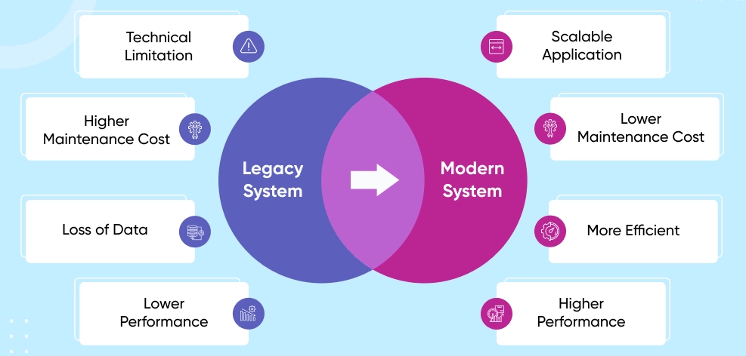
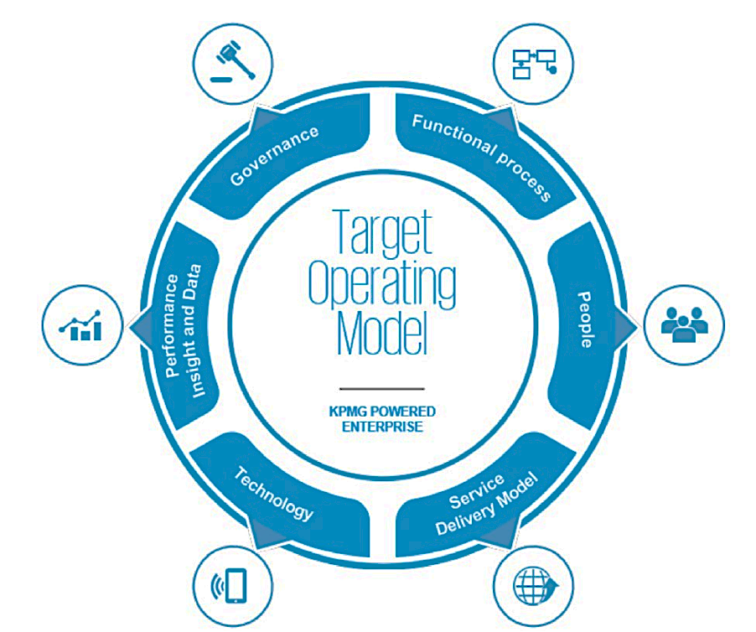

IDC Offering – App Modernization
IDC offers a range of services for modernizing applications, including a comprehensive approach that addresses both the backend functionality and user experience. IDC helps move legacy workloads to a modern cloud platform and break down large, monolithic applications into smaller microservices, using modern methodologies such as DevOps, Site Reliability Engineering (SRE), and CI/CD as part of the modernization process.
© 2025 IDC Technologies. All rights reserved - Confidential
Notes:
Generated by Copilot IDC offers a comprehensive application modernization service that focuses on both backend functionality and user experience enhancements. They assist organizations in migrating legacy workloads to modern cloud platforms and decomposing large monolithic applications into smaller, manageable microservices. The modernization process incorporates modern methodologies such as DevOps, Site Reliability Engineering (SRE), and continuous integration/continuous deployment (CI/CD) to ensure agility, scalability, and improved performance. ______

Slide 9




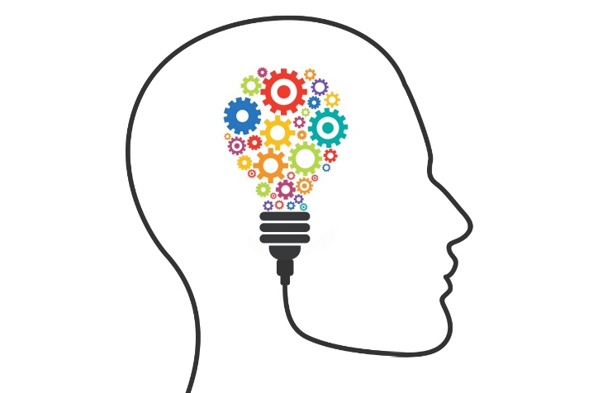

IDC Offering – App Modernization
IDC Technologies is well-versed in Agile-based deliveries. We will use an Agile/iterative approach to app modernization and project management(if required) that will help teams deliver value to their customers faster.
Understand
Automobile
DECIDE
Implementation
validate
BSFI
SKETCH
- Define the who?
- Meet with Business Sponsors
- Understanding of Legacy System
- Killer Feature/ Capabilities
- Success Criteria for the week
- Prioritized concept ideas and
themes
- Define User personas
- Define solution for modernization
- First draft wireframes/mock-ups
- Choose the best idea
- Storyboards/ refined wire-frames
- Business Blueprint / Architecture
Blueprint
- Conceptual Architecture
- Design Execution
- Risk & Assumptions
- Integration
Data / Code Migration
- Deployment
- Refined execution ready for test
- Present Product Vision
- Validate Commercials
- Training and Support
Ideal Team
Product Owner
Tech Architect
Cloud Architect
UX Architect
QA Architect
Output
Buy‐in from Business on Product Vision
© 2025 IDC Technologies. All rights reserved - Confidential
Notes:
Generated by Copilot IDC leverages Agile and iterative methodologies for application modernization and project management, enabling faster delivery of value to customers. The process includes prioritizing concept ideas, defining user personas, and developing solution designs with wireframes and architecture blueprints. Execution involves risk management, integration, data migration, and deployment, followed by testing, validation, and training. The ideal team comprises product owners, technical architects, cloud architects, UX architects, and QA architects, all collaborating to ensure successful modernization outcomes. ______

Slide 10
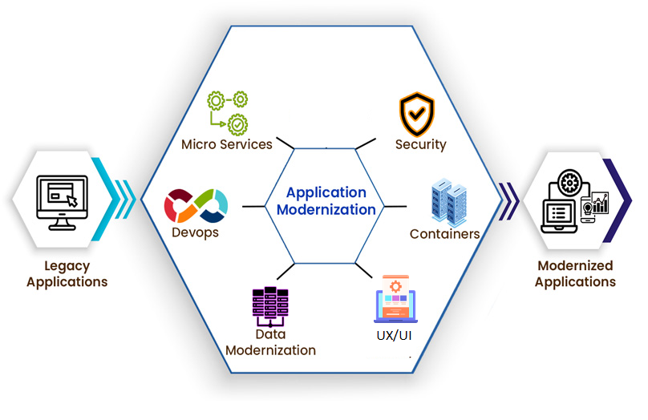
App Modernization – Our Services
Microservices:
IDC modernizes applications by implementing microservice patterns. This involves breaking down a monolithic application into smaller, independent "microservices." Each microservice is a small, specialized unit of functionality, making it easier to maintain and update, compared to a large monolithic application. Additionally, microservices can be scaled individually, rather than scaling the entire application, resulting in more efficient resource utilization and improved performance.
Containers:
IDC modernizes applications by utilizing a containerization approach, which allows them to run on any platform that supports containerization technology, without concerns about dependencies or system configuration. IDC employs various container runtimes such as Docker, and CIR-O, as well as multiple container orchestration tools such as Kubernetes and Openshift.
DevOps:
IDC implements DevOps automation by utilizing tools such as Jenkins or Terraform to automate repetitive tasks such as testing, deployment, and infrastructure provisioning. This enables organizations to quickly and dependably roll out new features. IDC also employs advanced deployment techniques like Rolling updates, Canary Releases, and Blue-Green to achieve zero downtime during deployment.
Data Modernization:
IDC modernizes data for both SQL and No-SQL databases by synchronizing, replicating, and transferring data. We ensure that replication on the platform continues to function seamlessly after migration. IDC also migrates data from on-premises RDBMS to Cloud RDBMS and performs transformations from RDBMS to No-SQL.
© 2025 IDC Technologies. All rights reserved - Confidential
Notes:
Generated by Copilot IDC's application modernization services include implementing microservices architecture, which breaks down monolithic applications into smaller, independent units for easier maintenance and scalability. They utilize containerization technologies like Docker and Kubernetes to ensure platform independence and efficient orchestration. DevOps automation tools such as Jenkins and Terraform streamline testing, deployment, and infrastructure provisioning, enabling rapid and reliable feature releases with zero downtime through advanced deployment strategies. Data modernization services cover migration and synchronization of SQL and NoSQL databases, ensuring seamless data replication and transformation during cloud migration. ______

Slide 11
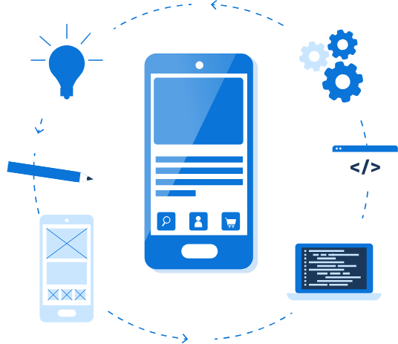
App Modernization Solution
IDC provides a comprehensive solution to migrate monolithic applications to modern, high-performance and scalable architecture-based applications.
IDC offers a comprehensive solution to address all your cloud migration needs. With years of experience, we have a proven track record of successfully migrating to the cloud.
IDC designs, builds, and manages custom, cloud-native applications that are driven by business needs.
IDC offers effective services to optimize infrastructure for improved performance and cost savings.
IDC automates infrastructure to minimize manual intervention and ensure a highly available system.
IDC's solutions stand out from the competition by providing tailored solutions that are the best fit for specific use cases.
© 2025 IDC Technologies. All rights reserved - Confidential
Notes:
Generated by Copilot IDC provides a comprehensive application modernization solution that migrates monolithic applications to modern, scalable architectures. Their services cover all aspects of cloud migration, custom cloud-native application development, infrastructure optimization for performance and cost savings, and automation to ensure high availability. IDC's tailored solutions are designed to fit specific use cases, differentiating them from competitors by focusing on business-driven outcomes and seamless cloud integration. ______

Slide 12
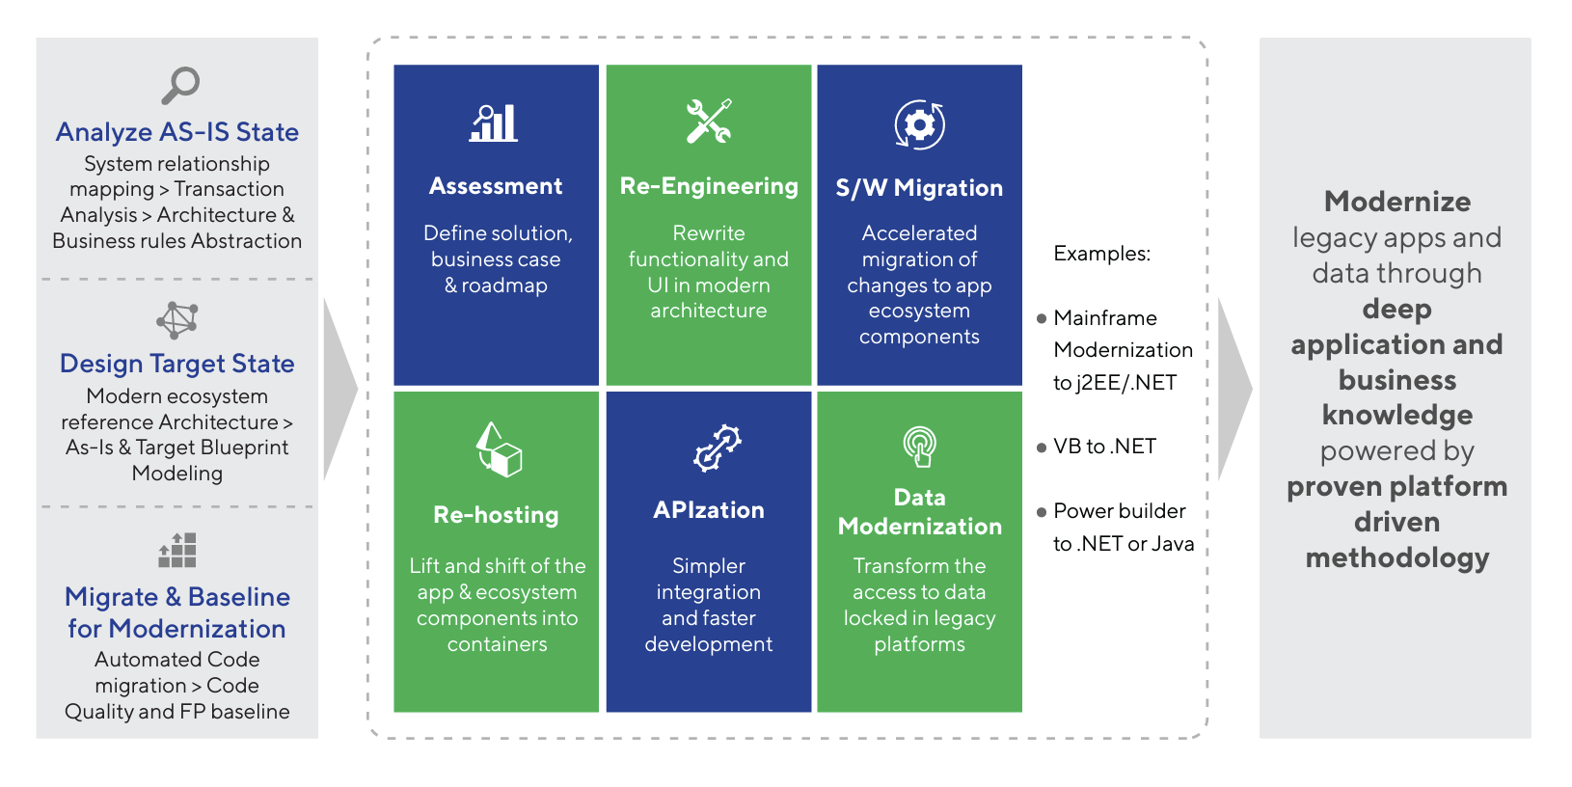
Platform Driven Methodology for Accelerated Outcomes
Modern ecosystem reference framework," built from our extensive experience in modernization projects, to create a customized digital transformation plan tailored to the client's needs. Our platform-based approach, implemented through a streamlined factory model, guarantees an optimal outcome for each application upon completion. Our services include Re-hosting, Re-engineering, APIzation, Software Migration, Data Modernization, and Optimization.
© 2025 IDC Technologies. All rights reserved - Confidential
Notes:
Generated by Copilot IDC employs a platform-driven methodology for accelerated modernization outcomes, leveraging a modern ecosystem reference framework developed from extensive project experience. This approach enables customized digital transformation plans tailored to client needs, executed through a streamlined factory model to ensure optimal results. Key services include re-hosting, re-engineering, API integration, software migration, data modernization, and optimization, all designed to deliver efficient and effective application modernization. ______

Slide 13
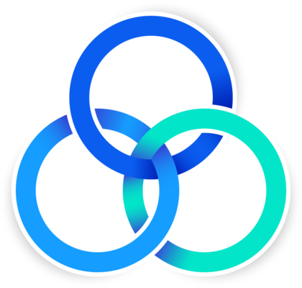
Application Modernization Features
People: Optimize human systems
It is crucial to establish teams that support the delivery of value streams, rather than dividing the value stream across departments based on functional roles.
A department of developers, testers, operators
Smaller teams with tight interlinkage are higher functioning
DevSecOps integrates security throughout the development cycle
PEOPLE
Process: Automate the interaction between people and technology
IDC conducts an application portfolio assessment to prioritize applications for modernization and determine the most effective migration strategies.
We also establish application archetypes, recurring patterns that serve as a reference for other applications with similar characteristics within the organization.
PROCESS
Technology
Technology: Support modernization
IDC offers a self-service model for Kubernetes or containerized applications, which creates a more agile and responsive environment that allows for faster release of new features and services to better adapt to rapid market changes and customer needs.
© 2025 IDC Technologies. All rights reserved - Confidential
Notes:
Generated by Copilot Application modernization at IDC focuses on three pillars: people, process, and technology. Optimizing human systems involves forming cross-functional teams that support value streams rather than siloed departments, with DevSecOps integrating security throughout development. Process automation enhances interactions between people and technology, supported by application portfolio assessments and archetype identification to prioritize modernization efforts. Technologically, IDC offers self-service models for Kubernetes and containerized applications, fostering agility and faster feature releases to adapt quickly to market and customer demands. ______

Slide 14
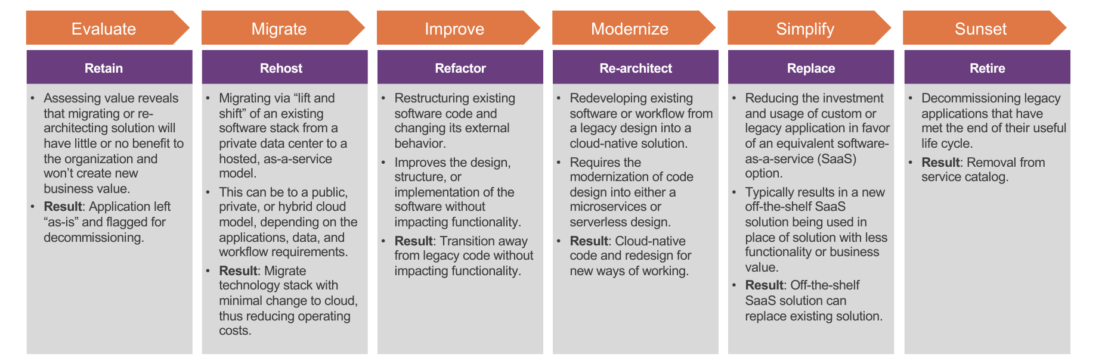
How we deliver Application Modernization
Before beginning the application modernization process, IDC conducts a requirement-gathering session to gain a deeper understanding of the current system, followed by an assessment that collects information on each component in the system.
We then analyze the input received during the assessment, and subsequently, commence the implementation of the application modernization.
Assessment
Planning
Design
Development
Testing
Maintenance
© 2025 IDC Technologies. All rights reserved - Confidential
Notes:
Generated by Copilot IDC begins application modernization with thorough requirement gathering to understand the current system comprehensively. This is followed by an assessment phase that collects detailed information on each system component. The insights gained guide the analysis and planning stages, ensuring that the modernization implementation is well-informed, targeted, and aligned with business objectives, leading to a successful transformation. ______

Slide 15
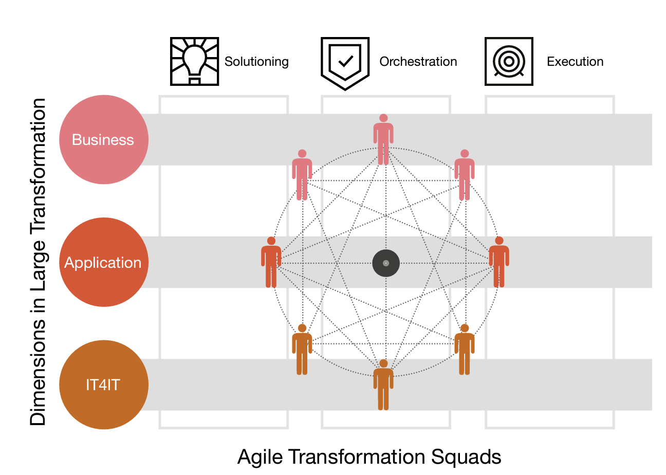

Agile Transformation Squads
Solutioning
With a thorough understanding of our clients and the ability to solve complex problems; create (technical) solutions; re-imagining the possible.
Orchestration
Able to orchestrate decision-making by navigating corporate politics throughout the full spectrum of stakeholders (C-Suite to engineer); also creating business cases and roadmaps.
Execution
Driving execution of initiatives through strong (agile) program management skills with a strong focus on outcomes: having a solid vision, but striking a delicate balance with being agile. Although we will not be coding, we will fire start and drive your initiative.
In addition to these capabilities, it is important to cover all aspects from strategy to infrastructure, in order to fully support these legacy transformations. Next to aligning with the more obvious IT skills in the application layer and understanding your IT4IT, it is also crucial to align these IT capabilities with the businesses these capabilities are designed to support. In quite a lot of situations you will need to have a fully functional roadmap, with an alternative platform for every single piece of functionality, and put this on the backlog of business.
© 2025 IDC Technologies. All rights reserved - Confidential
Notes:
Generated by Copilot Agile transformation squads at IDC cover the full spectrum from strategy to infrastructure, ensuring legacy system transformations are fully supported. Aligning IT capabilities with business needs is critical, often requiring detailed roadmaps and alternative platforms for each functionality. IDC's approach includes solutioning—creating innovative technical solutions; orchestration—navigating stakeholder decision-making and building business cases; and execution—driving initiatives with strong agile program management focused on outcomes, balancing vision with flexibility to accelerate transformation. ______

Slide 16

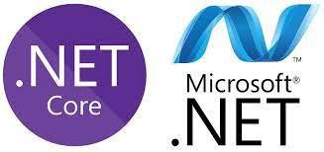


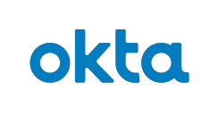




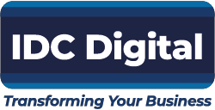
App Modernization: Hamriyah Free Zone Authority Sharjah Government
The Objective
The client aimed to develop a smart, platform-based mobile application designed to host a range of essential business services. The app's key functionalities included features like port application approvals, real-time senior management notifications, and other critical operational workflows. This solution was envisioned to streamline processes, enhance decision-making efficiency, and provide a unified digital experience for all business stakeholders.
Business Need
The client was looking to accelerate ITs innovation strategy by converting their monolith middleware into containerized microservices. Client was completely on- premises, looking for a way to move toward their cloud-first strategy.
The IDC Solution
IDC helped the client by strangulating existing monolithic application into unique microservices that allowed smart approval workflows.
Key Benefits
Increased Customer Interactions for Senior management and above
Insulates changes to backend systems and enabled reliable delivery
Reduced time to market
10% reduction in cost for release of new features.
Canary and feature flagging
leads to testing in production.
Usage of API Gateway for governed service access from all channels brought unified standardization.
Realtime curated data was consumed from EDP and Data science models via REST API's.
Fault tolerant and scalable, customized platform leads to higher reliability and faster delivery.
The client was looking for building a platform based smart mobile app that will hosts common business services such as port application approvals, senior management notifications etc.
© 2025 IDC Technologies. All rights reserved - Confidential
Notes:
Generated by Copilot For the Hamriyah Free Zone Authority in Sharjah, IDC developed a smart, platform-based mobile application to host essential business services like port application approvals and real-time senior management notifications. The client aimed to transform their monolithic middleware into containerized microservices aligned with a cloud-first strategy. IDC implemented an API Gateway for standardized service access and integrated real-time data from enterprise data platforms and data science models. The solution improved reliability, accelerated delivery, increased customer interactions, reduced time to market, and lowered costs through advanced deployment techniques like canary releases and feature flagging. ______

Slide 17
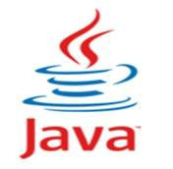

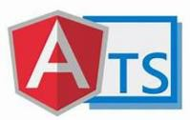
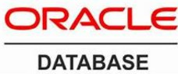
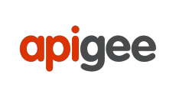

Design & Develop software for NSE Parivartan Portal
The Objective
The client WIPRO sought IDC as
a partner to develop software for NSE Parivartan Portal.
Business Need
The client was looking to accelerate ITs innovation strategy by converting their manual process into digitally automated Portal involving Key stakeholders like Listing Compliance and Member Compliance for Statement of Deviation & Variation, Insurance Submission and Base Minimum Capital.
The IDC Solution
IDC helped the client by strangulating existing monolithic application into unique microservices that allowed automated workflows by following SonarQube Standards.
Key Benefits
Parivartan Portal which will be largely digital thereby eliminating manual tracking of Mails to ANMI and BBF Insulates changes to backend systems and enabled reliable delivery.
Simplify data check within the application digitally.
Automate the manual check
process.
Full project life cycle ownership: successful project delivery including full implementation from initiation to deployment for one major or several minor initiatives simultaneously.
All manual checks / validations and processes involved are automated for entire process.
Technical Design document, Development and Unit testing is successfully covered for Insurance Submission, BMC and Statement of Deviation & Variation process.
© 2025 IDC Technologies. All rights reserved - Confidential
Notes:
Generated by Copilot IDC partnered with WIPRO to develop software for the NSE Parivartan Portal, automating manual processes involving key stakeholders such as Listing Compliance and Member Compliance. The modernization involved breaking down monolithic applications into microservices and automating workflows following SonarQube standards. The solution digitized manual checks and validations, simplifying data verification and enabling full project lifecycle ownership from initiation to deployment, resulting in reliable delivery and enhanced operational efficiency. ______

Slide 18
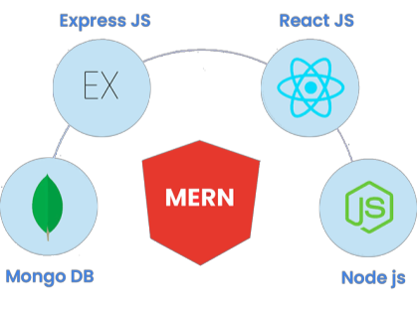
Loan Origination System Development
The Objective
To develop a robust loan origination system that would enhance operational efficiency, improve customer satisfaction, and reduce the turnaround time for loan approvals.
Business Need
A financial institution identified a significant opportunity to streamline and automate their loan origination process. The existing manual process was time-consuming, error-prone, and led to delays in loan approvals, resulting in a suboptimal customer experience.
The IDC Solution
We developed a comprehensive software tailored to the needs of the financial institution. The solution leveraged modern technologies and best practices to automate the loan origination process.
Delivery
Accurate Credit Risk Assessment: Integration with credit bureaus and advanced credit scoring models enhanced the accuracy and consistency of credit risk assessments.
Regulatory Compliance: The software ensured compliance with regulatory requirements and facilitated smooth adherence to industry standards. Comprehensive audit trails and reports helped the financial institution meet regulatory obligations and simplified regulatory reporting.
Captured and validated applicant information, supporting various types of loans.
Incorporated credit scoring models and algorithms.
A centralized repository to manage documents.
A seamless collaboration and communication.
The business opportunity was to develop a robust loan origination system that would enhance operational efficiency, improve customer satisfaction, and reduce the turnaround time for loan approvals.
© 2025 IDC Technologies. All rights reserved - Confidential
Notes:
Generated by Copilot IDC developed a robust loan origination system for a financial institution to enhance operational efficiency, customer satisfaction, and reduce loan approval turnaround times. The solution automated the previously manual, error-prone process by capturing and validating applicant information, supporting various loan types, and incorporating advanced credit scoring models. Integration with credit bureaus improved risk assessment accuracy, while comprehensive audit trails ensured regulatory compliance. The system also facilitated seamless collaboration and document management, streamlining the entire loan origination workflow. ______

Slide 19
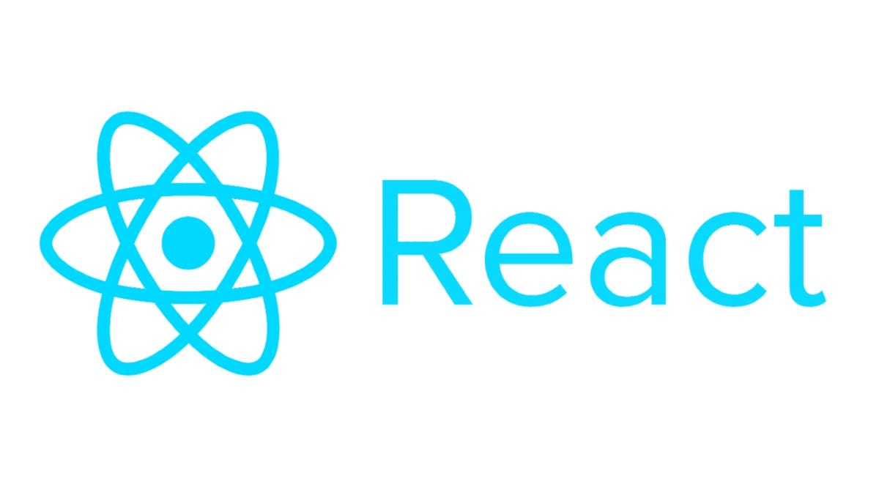

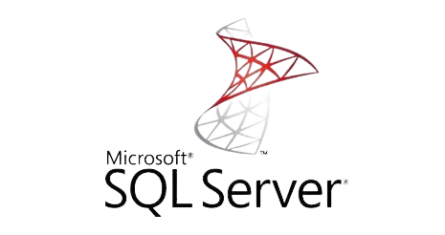
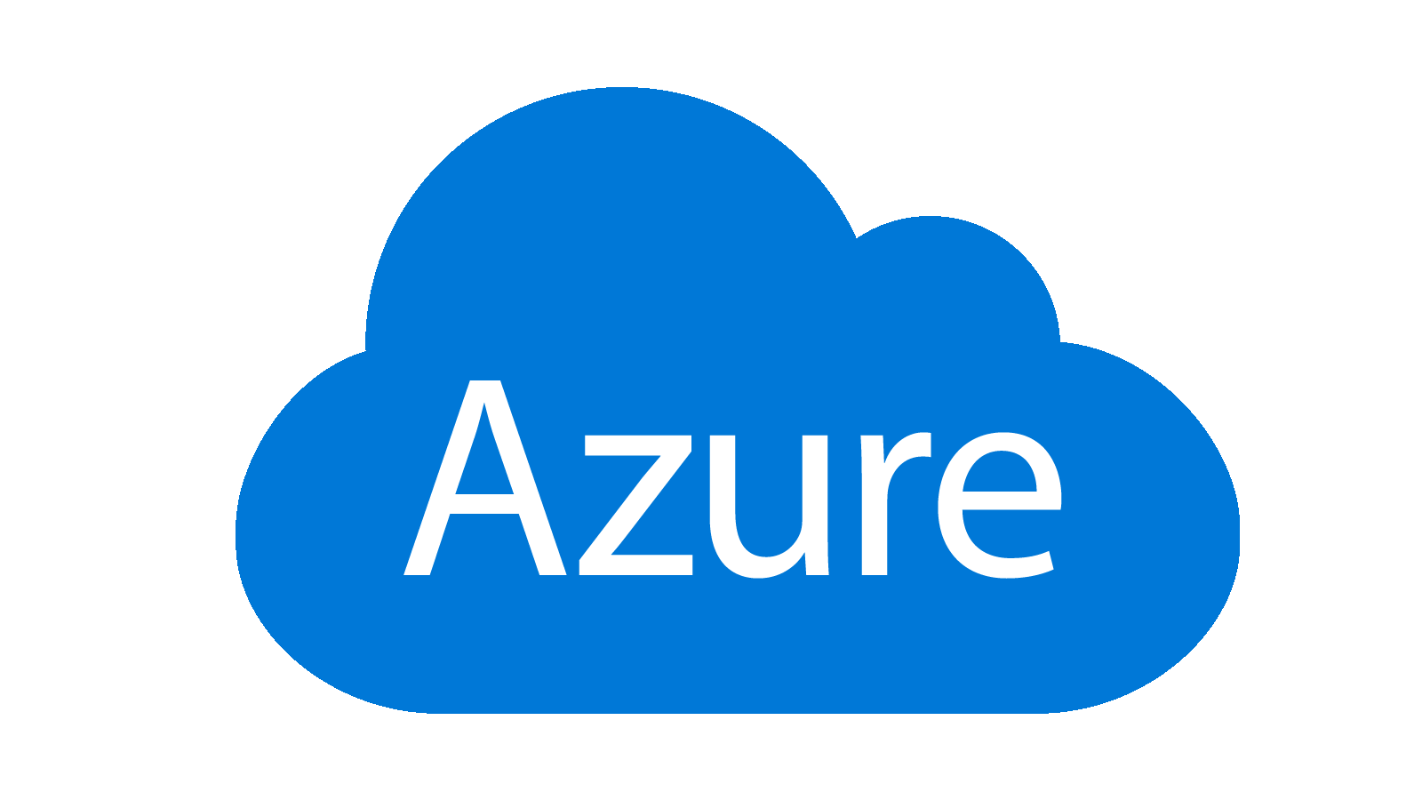
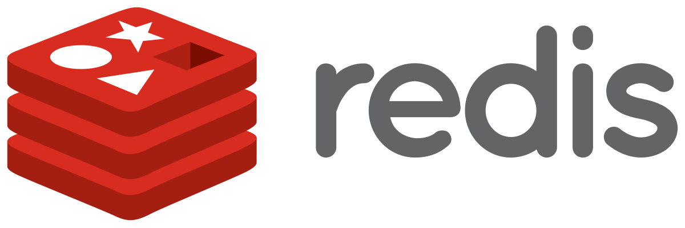
Sahatna Mobile App Development
The Objective
To provide a comprehensive, user-friendly digital platform that empowers individuals to take control of their healthcare journey by streamlining access to essential healthcare services, information, and support in a secure and convenient manner.
Business Need
The client seeks an innovative solution to simplify healthcare processes, improve patient engagement, and ensure seamless communication between patients and healthcare providers. The app addresses the growing demand for accessible healthcare services, telehealth capabilities, and proactive health management tools in a connected and digital-first world.
The IDC Solution
Cloud-Based Microservices Architecture: Ensures scalability, high availability, and seamless integration with external healthcare systems like EHR/EMR for secure data exchange.
Mobile Application: A user-friendly app enabling patients to schedule appointments, access health records, track medications, and connect via telehealth services anytime, anywhere.
Admin Portal: A centralized platform for healthcare providers to manage appointments, monitor patient data, and send timely notifications for improved operational efficiency.
Delivery
Accurate Credit Risk Assessment: Integration with credit bureaus and advanced credit scoring models enhanced the accuracy and consistency of credit risk assessments.
Regulatory Compliance: The software ensured compliance with regulatory requirements and facilitated smooth adherence to industry standards. Comprehensive audit trails and reports helped the financial institution meet regulatory obligations and simplified regulatory reporting.
© 2025 IDC Technologies. All rights reserved - Confidential
Notes:
Generated by Copilot IDC developed the Sahatna mobile app to empower individuals in managing their healthcare journey through a secure, user-friendly digital platform. The app offers features such as appointment scheduling, health record access, medication tracking, and telehealth connectivity. Built on a cloud-based microservices architecture, it ensures scalability and high availability while integrating securely with external healthcare systems like EHR/EMR. An admin portal enables healthcare providers to efficiently manage operations and patient data, enhancing engagement and streamlining communication in a digital-first healthcare environment. ______

Slide 20
Thank You
Notes:
Generated by Copilot Thank you for your attention. We appreciate the opportunity to present IDC Technologies' capabilities and solutions. Please feel free to ask any questions or discuss how we can support your digital transformation journey. ______

